Slide 1
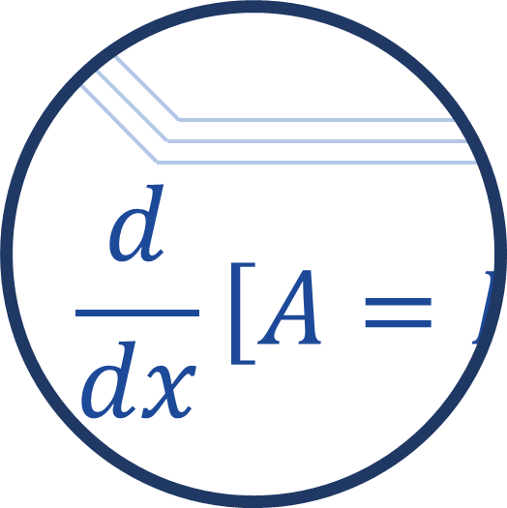
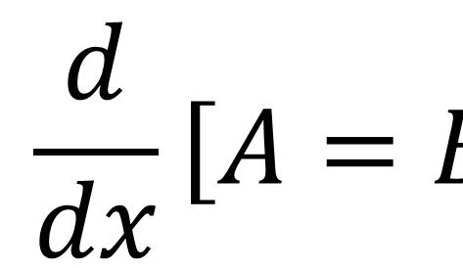

$$\frac{d}{dx}\left[A=B\right]$$

Slide 2
5
-5
0
5
-5

Slide 3
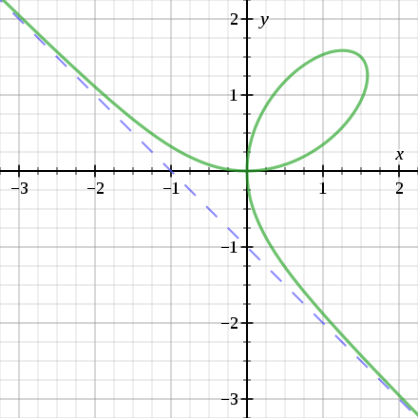
Graph 2© 2010 Georg-Johann

Slide 4
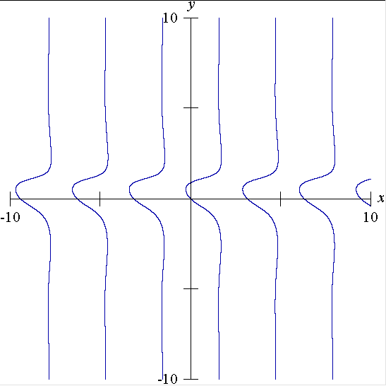

Slide 5
